Slide 1
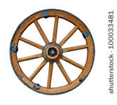



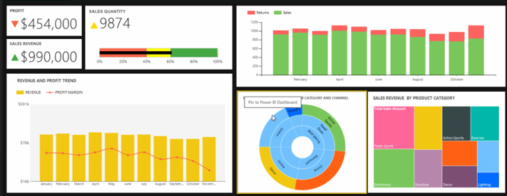



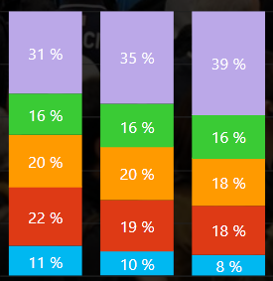
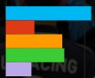
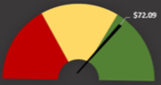






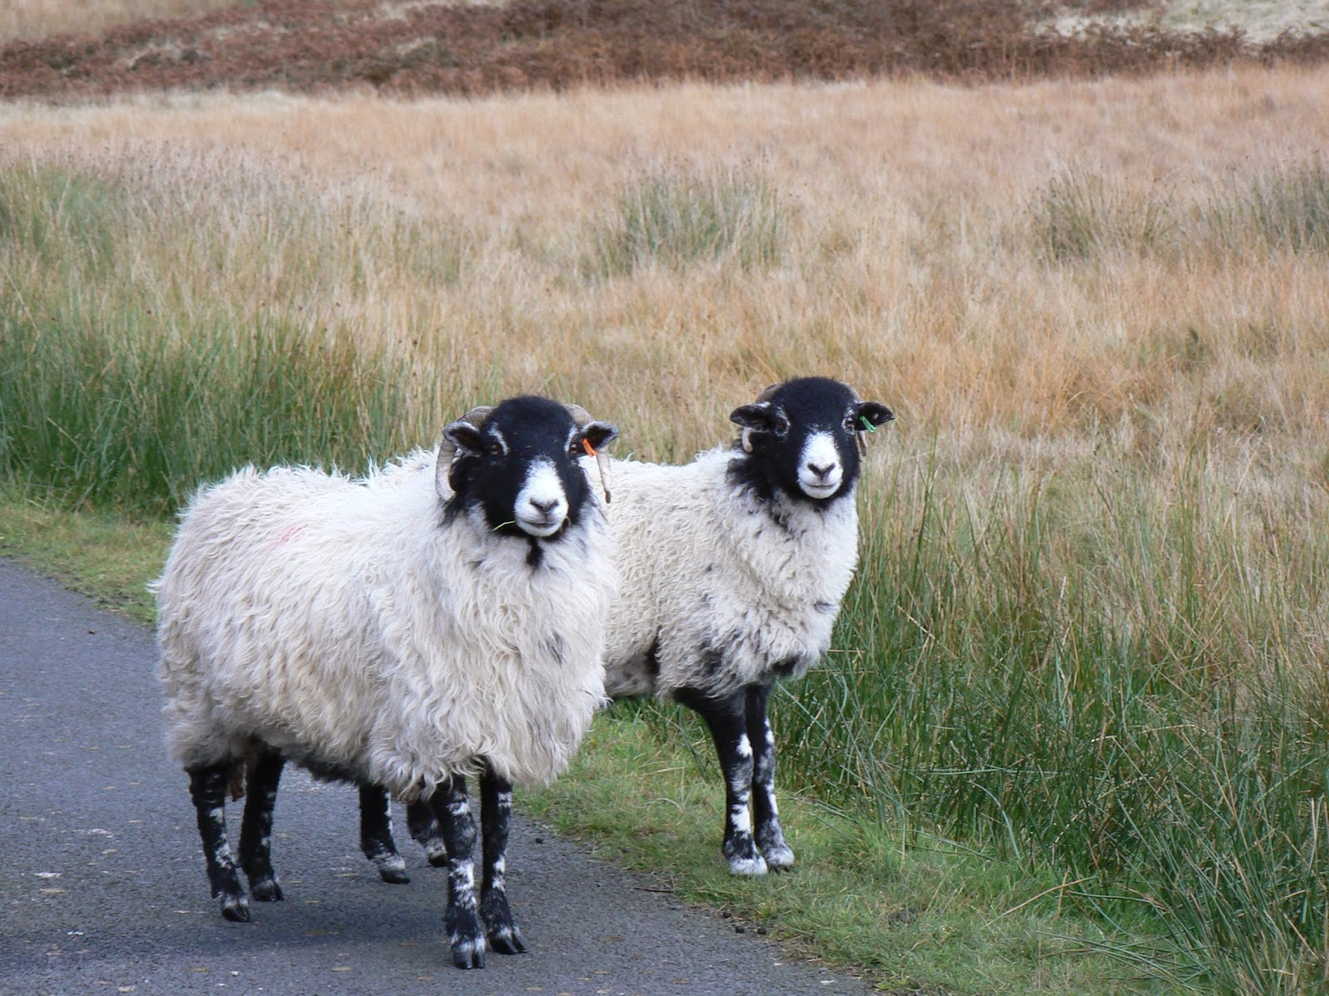
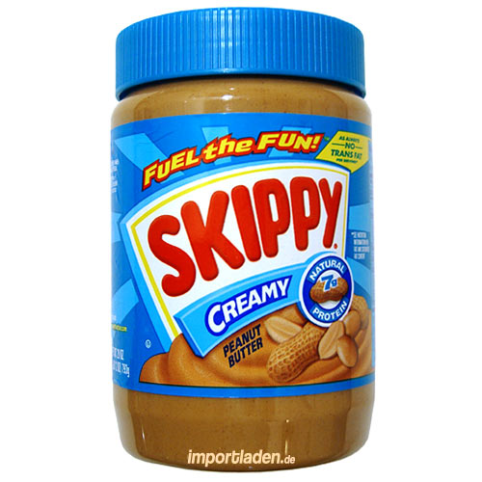


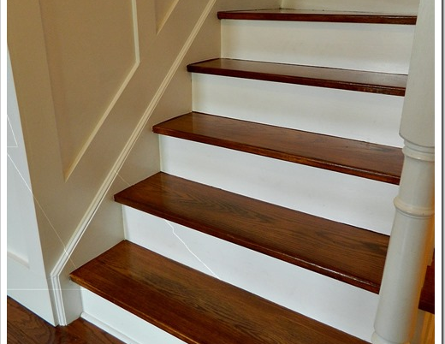

Power BI reports best practices AKA What I’ve learned so far about report design
1. We’l adv + from industry experts.
Reall gr+8 reports s s and s, and while that R - - - GR + 8.
Learn how the + I re+ +itor 2 do lots of fun . .
a terrific re + , by .
And I’ll try to answer as many questions as I can ☺

Slide 2

Resources
Michele Hart, mihart@Microsoft.com
powerbi.microsoft.com
community.powerbi.com
Gallery: app.powerbi.com/visuals
Submit and vote on ideas: ideas.powerbi.com
YouTube: Microsoft Power BI channel
Experts: Stephen Few, Edward Tufte, darkhorseanalytics, Andy Kirk, Lachlan James, William McKnight, Boris Evelson (Forrester),
Notes:
Swag for good questions, auction off remainder at end.

Slide 3
What is a “report”
Collection of related visuals that appear together on 1 or more pages
Reports feed dashboards
Reports have 1 or more pages
Behind each report full of visuals are thousands upon thousands of data points. Allow exploration.

Slide 4
Examples of BI reports

Slide 5
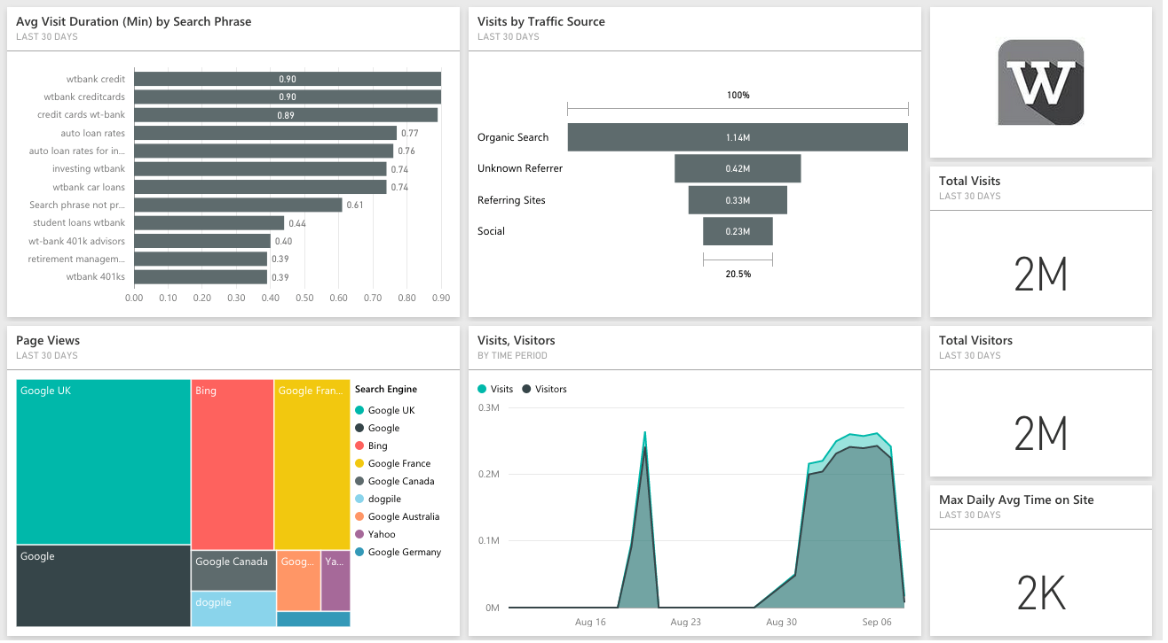

Slide 6
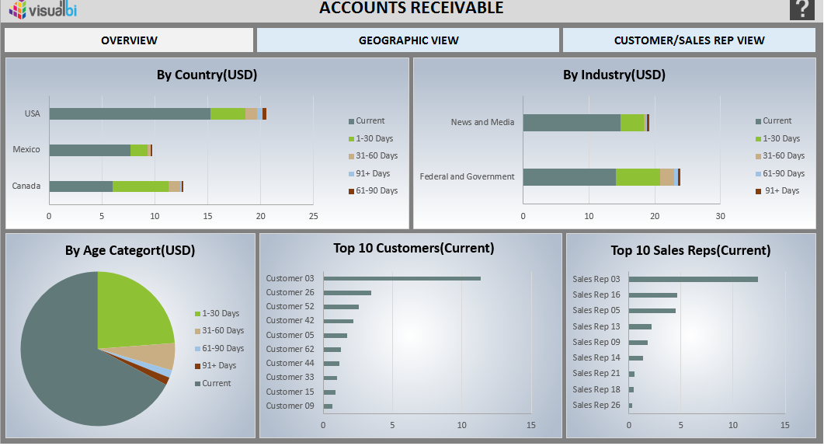

Slide 7
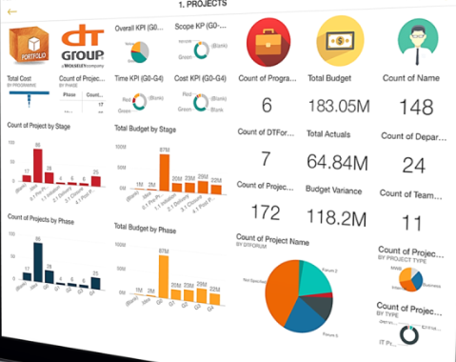

Slide 8
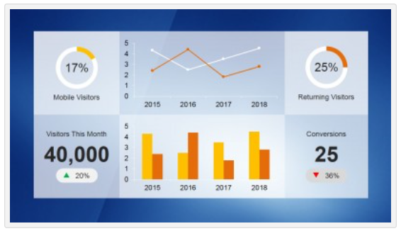

Slide 9
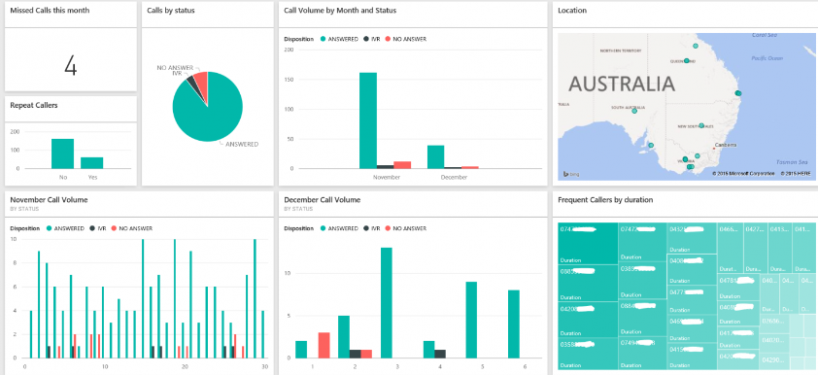

Slide 10
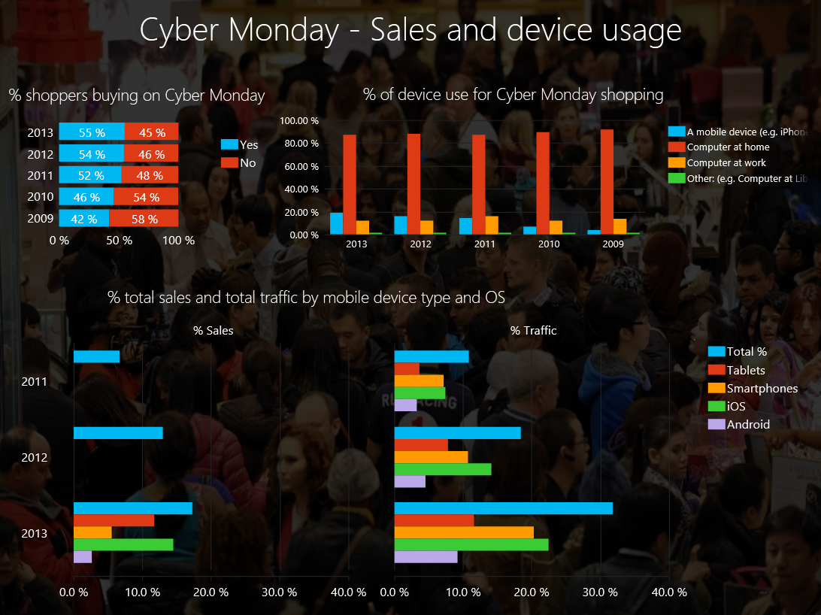

Slide 11
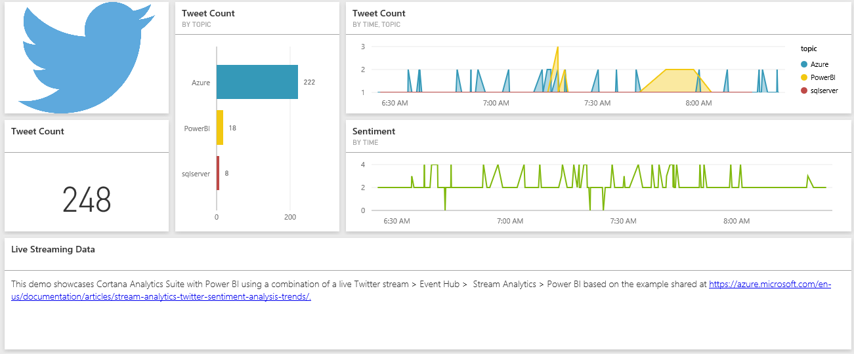

Slide 12
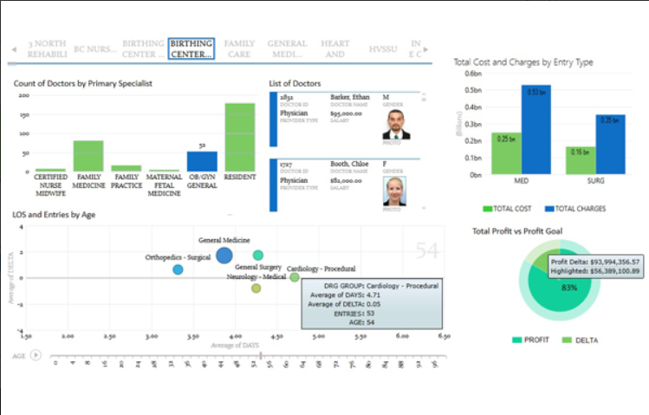

Slide 13
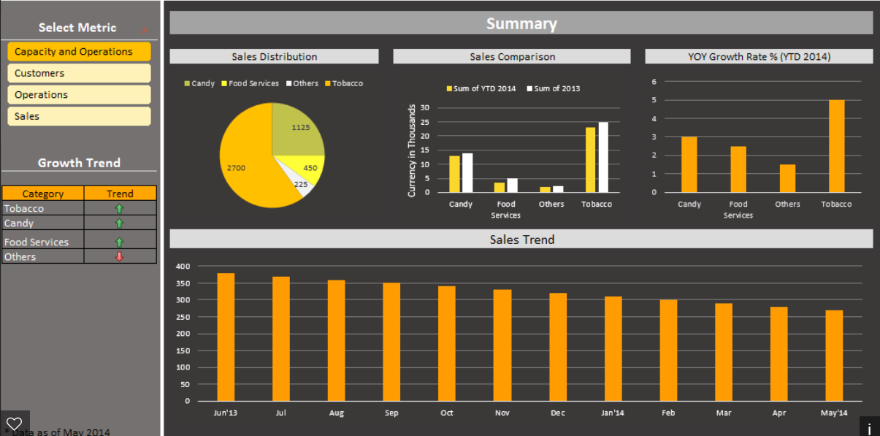

Slide 14
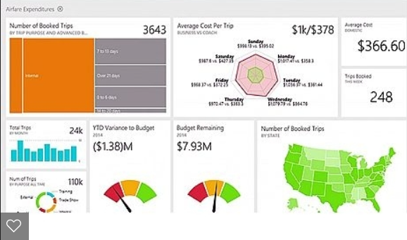

Slide 15
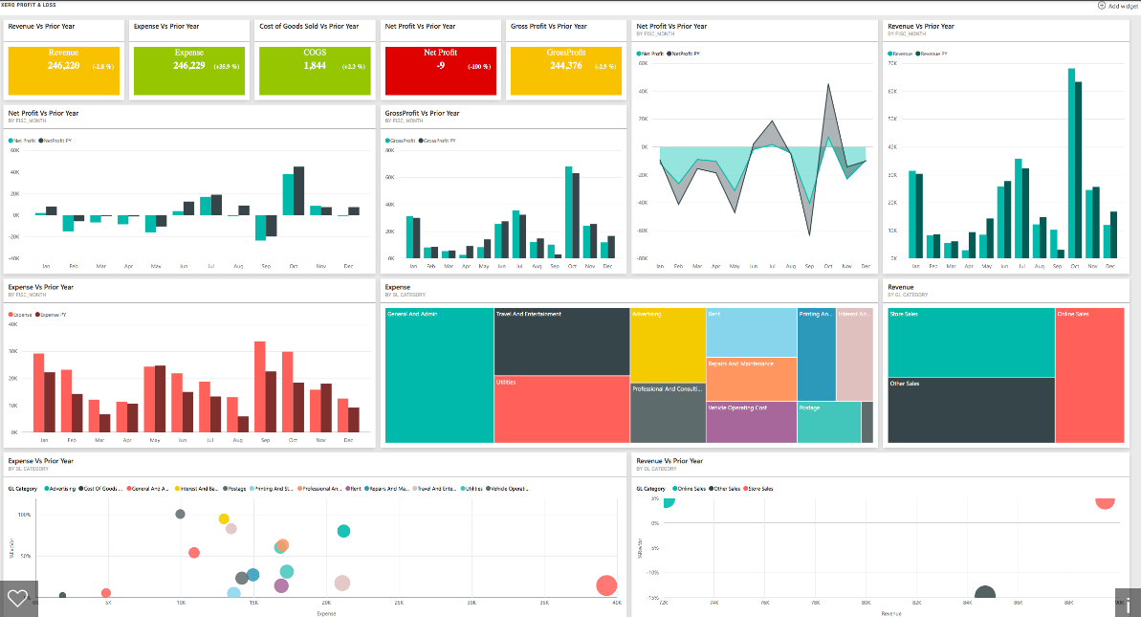

Slide 16
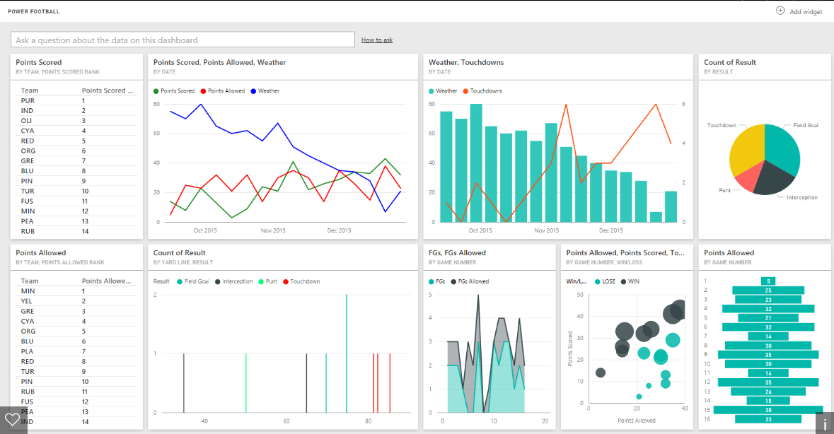

Slide 17
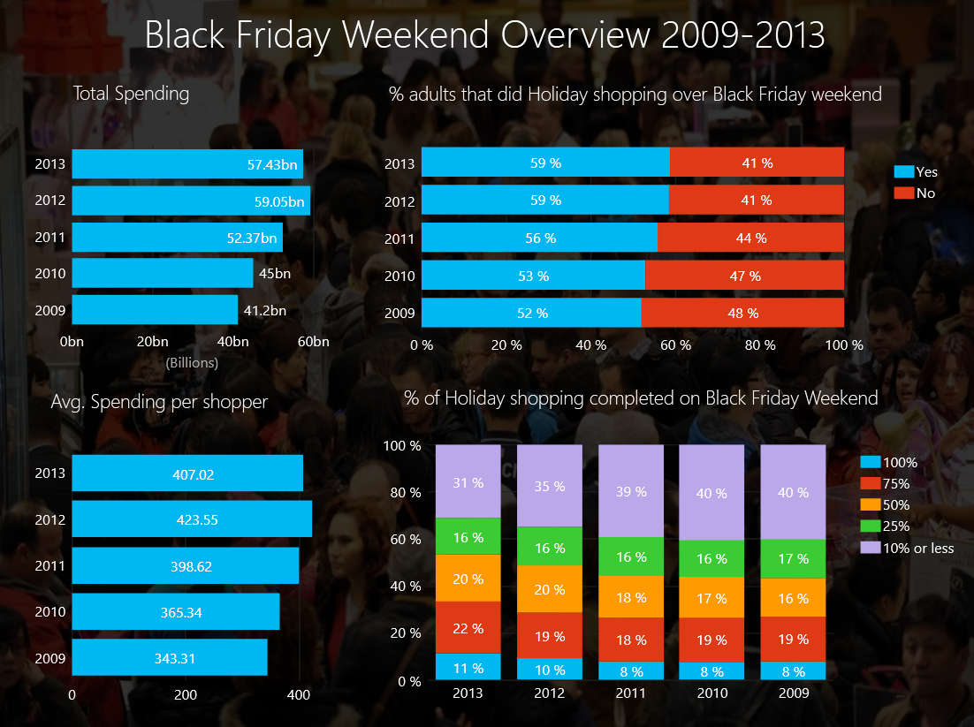

Slide 18
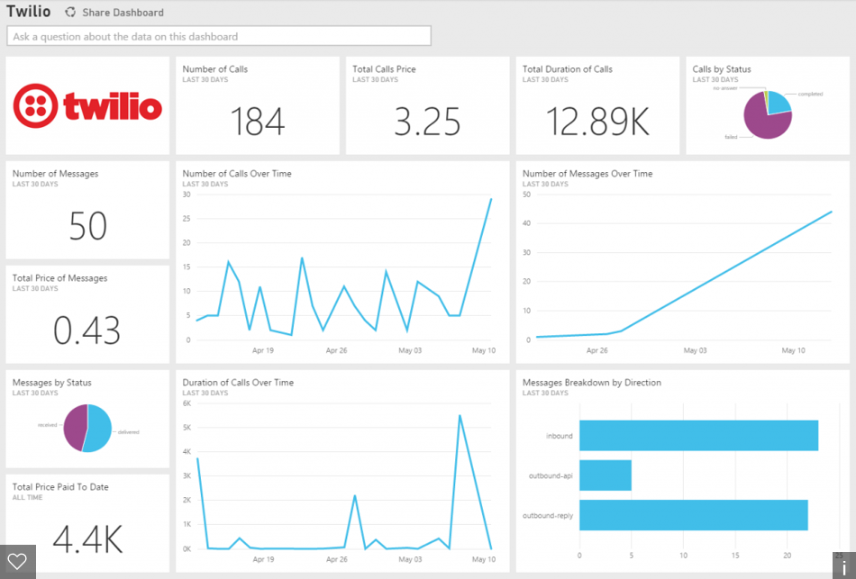

Slide 19
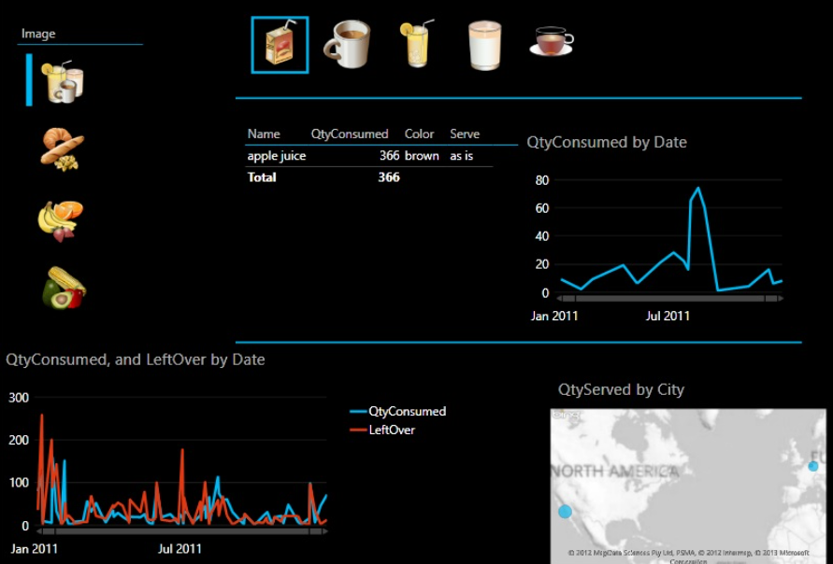

Slide 20
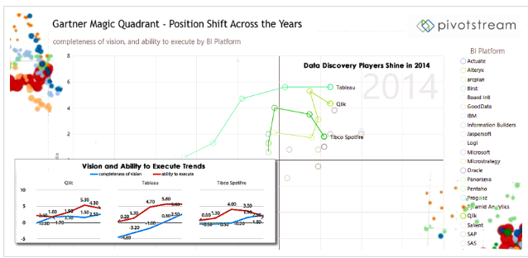

Slide 21
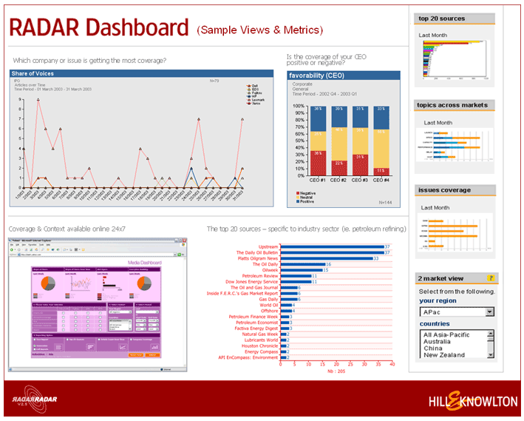

Slide 22
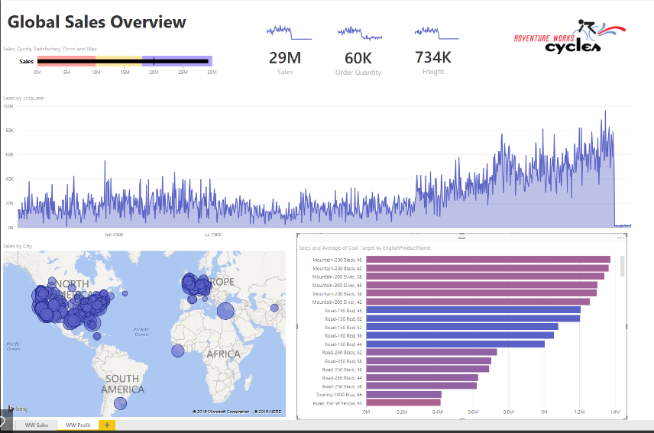

Slide 23
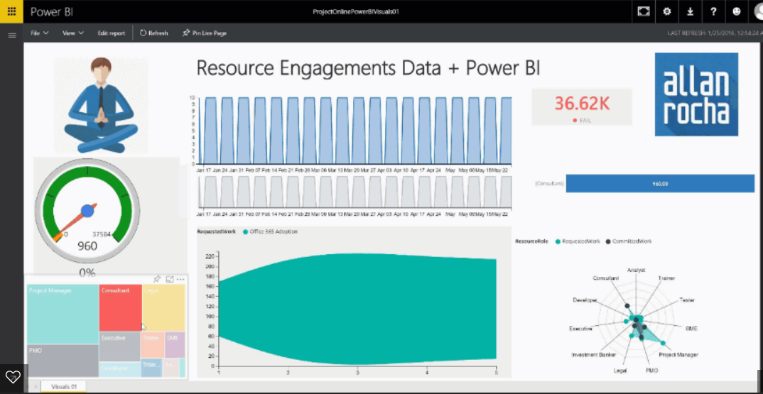

Slide 24
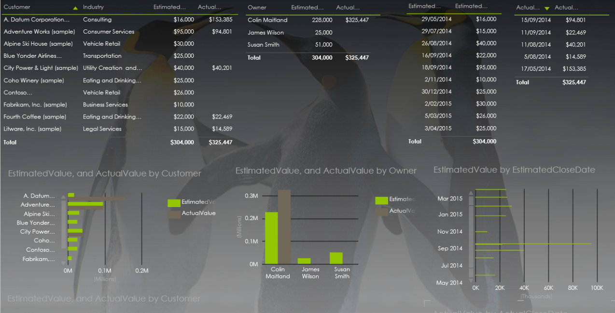

Slide 25
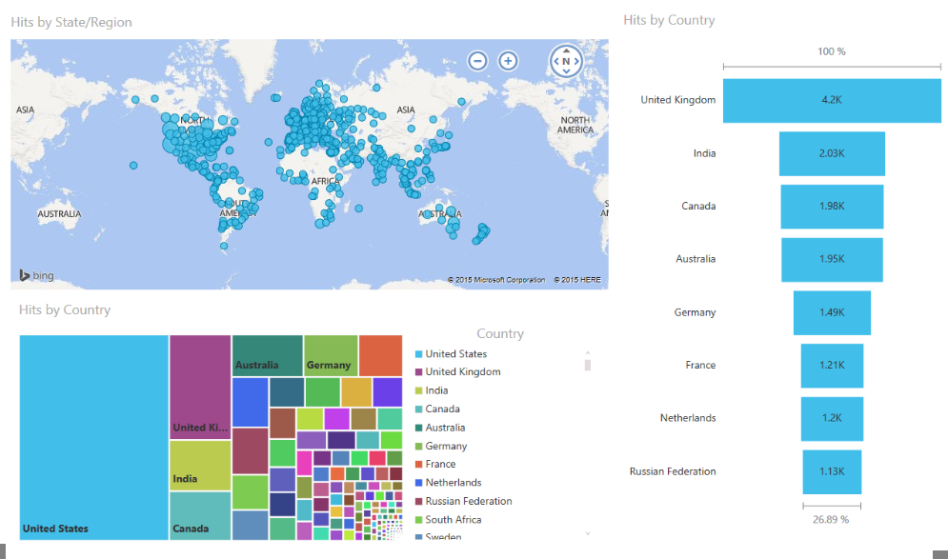

Slide 26
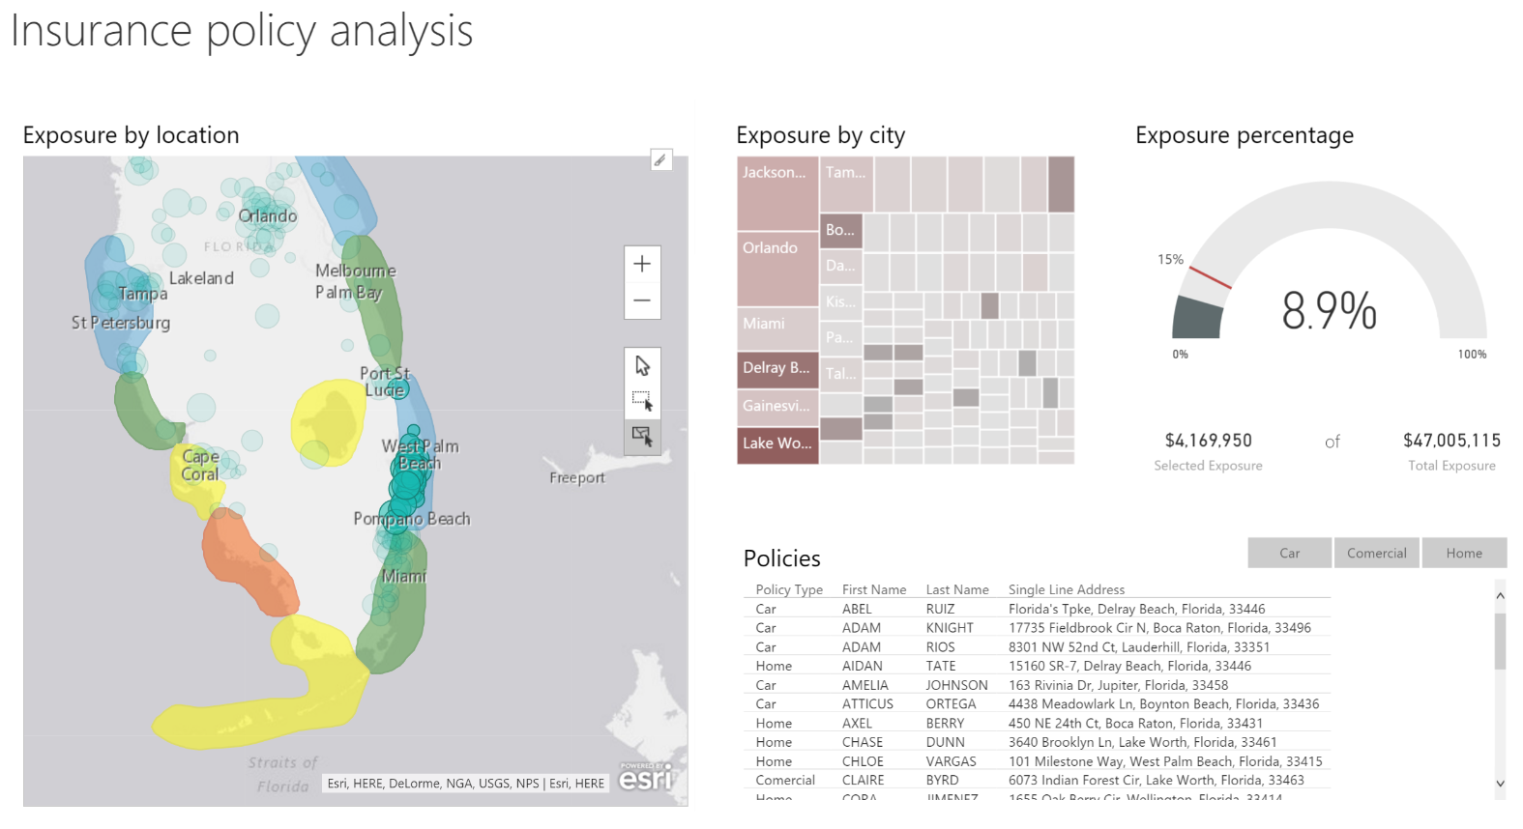

Slide 28
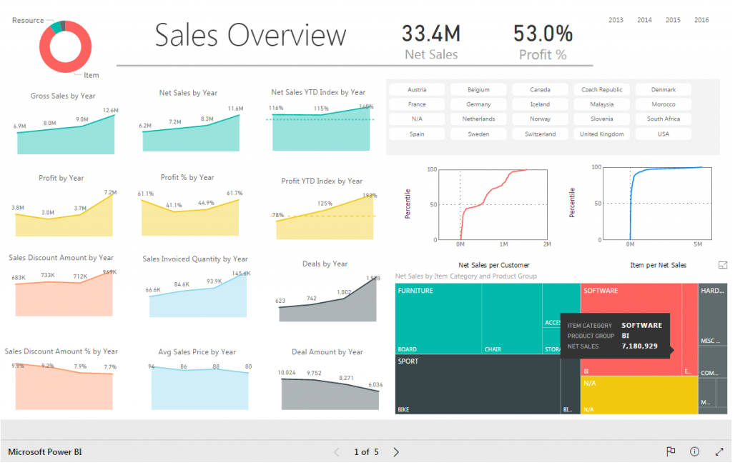

Slide 29
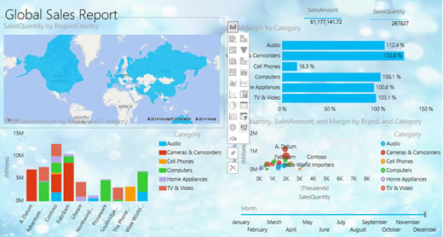

Slide 30
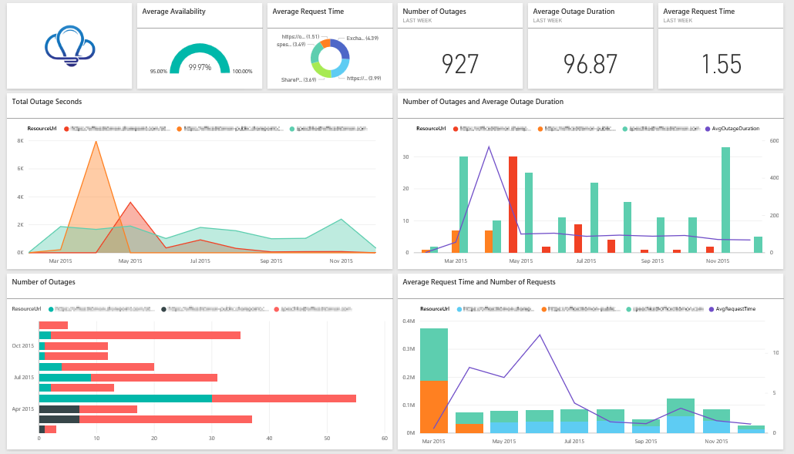

Slide 31
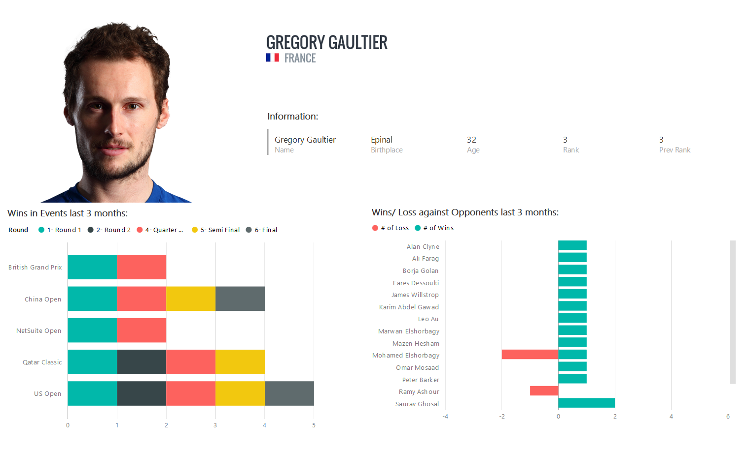

Slide 32
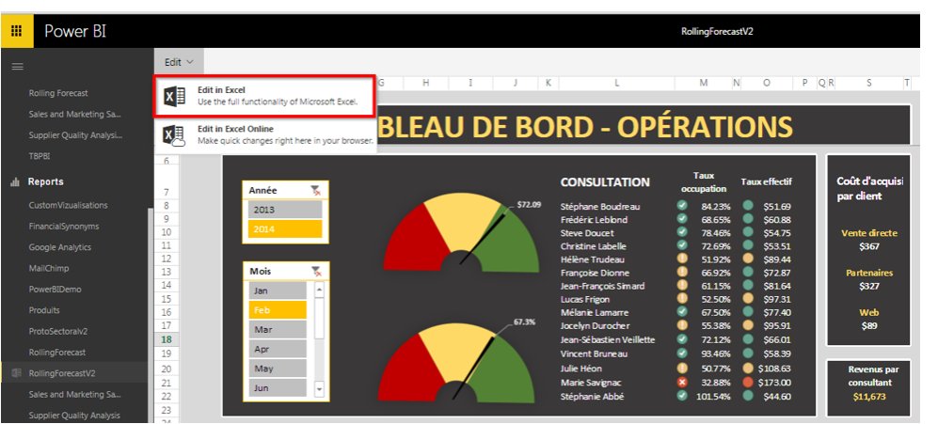

Slide 33
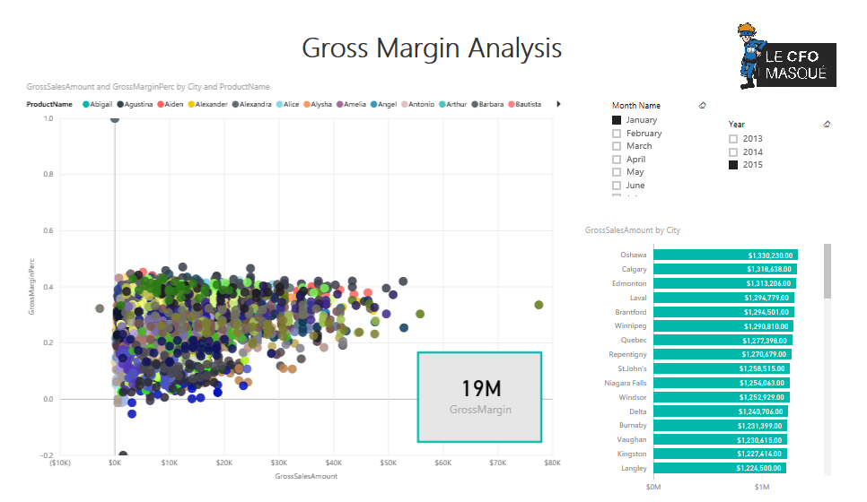

Slide 34
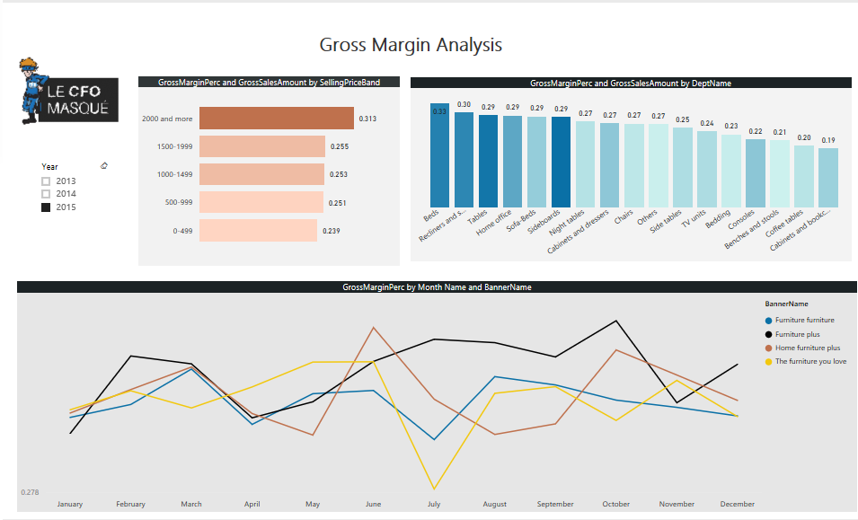

Slide 35
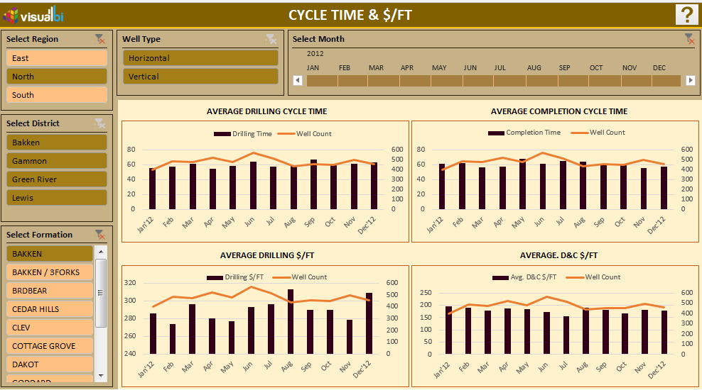

Slide 37
Where do I start?
With the DECISION MAKER
Analytics lives and dies on adoption by decision makers
Data-driven decision making is disruptive innovation.
What questions need to be answered?
Are these the right questions?
Notes:
Remember that some estimates put the failure rate of analytics projects at 80%. That’s almost twice as bad as the average IT project. How do you ensure your initiatives are firmly planted in the 20%? 1. Identify and interview DMs. Ask them what success would look like. Ask them for hypotheses and ideas. You’ll save ton time leveraging their expertise.
They’re used to using their GUT, analytics is the newcomer, the DISRUPTOR. 2. win some battles, build credibility, prove yourself. 3. Many projects fail bc answer the wrong question. Mitigate this by talking more.

Slide 38
Where do I start, continued
With the AUDIENCE
Who is the audience?
What is their knowledge of the area and comfort with reports and visuals?
With the DATA
Can my data answer the questions?
Permissions to the data?
Explore the data using visuals.
Look at your data elements through time, by category, by location. Run Quick Insights to find correlations, irregularities, and outliers. Something doesn’t look right, look closer.
Notes:
Start simple and build more-complex later. Use familiar terminology and data at level of detail and complexity on par with them. One size doesn’t fit all – create separate report pages with descriptions that allow audience to self-identify.
Answer some questions well rather than many questions poorly.
If not, circle back around to your Decision Makers and/or find the right data.
This exploration is for two purposes: to understand how the data reflects the business, and to identify the type and magnitude of data errors. (There will always be errors in your data, and it’s better to find them early.)
Go beyond sum, count, and average. There are so many ways to explore your data quickly.

Slide 39
What is unique about a dashboard and a report page?
Consolidating data into a purely visual format allows users to identify trends and make informed decisions far quicker than analyzing numbers.
Vision trumps other senses (Dr. John Medina)
We can’t see patterns in numbers alone.
Notes:
For processing info. We remember pictures. Takes longer to process text. Hear – remember 10% 3d later, add picture 65%. Many explanations, one is80-90% of info received by brain comes thru eyes, and about half brain function dedicated to directly or ind processing vision.
2. that’s why dashboards and reports are better than spreadsheets.

Slide 40
Design the report
“Elegance in communication is often achieved through simplicity of design”
Limited space to convey message
Fast/easy to “grok”
Can use it to make decisions
Plan for interaction
Revisit your business problem/questions
Notes:
Root of problem is not technology, bu tpoor data representation.
Space – must display dense info in small space in way that C clearly and quickly. This requires tapping into some BPs (Based on visual perception, human cognition, brain processing, and more). No technology can do this for you – need to learn this, design expertise.
In PBI, report has pages.
Create the simplest report that works. Its easier to explain to stakeholders, easier to build quickly. Stakeholders reluctant to base decisions on something they don’t understand.
Decisions –
Interaction - allow DM to play with the answer, what-if. Whatever, be able to change the inputs (date, location, assumption) and instantly see new results. Build a report for exploration NOT to show a single right answer.
Revisit – still on track?
they will shun it if it is not intuitive or consumes too much time and effort for the value it delivers

Slide 41

Enough with theory, let’s dive in!
Don’t be afraid, it will be FUN!

Slide 42
Report design

Slide 43
Layout – space NOTES
Canvas has finite amt space, hard to fit it all.
Tailor: audience, biz question, or progressive story. (meaningful helpful names)
PUG2, page 1
Space-related design issues: alignment, order, proximity, use of space, sorting, clutter
Notes:
Think about filling an art gallery. You wouldn’t put 50 pieces of artwork into a small room, fill it with chairs and paint each wall a different color. The curator chooses just pieces that have a common theme, lays them out around the room with plenty of space for visitors to move and think, and places informational cards that describes what they’re looking at. And there’s a reason most modern galleries have plain walls!

Slide 44
PUG Page 1 – Alignment, order, proximity
Layout impacts comprehension.
Layout guides reader through report page
How you place and position elements tells a story.
Story: start here and then look there” or “these 3 elements go together”
Most cultures: scan L to R, T to B. So put most-important top left. Organize rest in way tha tleads to logical nav and comprehension.
Position elements that require choice to L of vizs choice impacts
Convey relationships with borders or color backg. Conversely, use divider to distinguish differences
Use white space to visibly chunk
Fill the page. Too much white space, enlarge vizs.
But don’t let space availab dictate viz size – be intentional with sizing.
Need to draw attention? Make it bigger, add an arrow
Align elements, either sym or intentionally asym

Slide 45
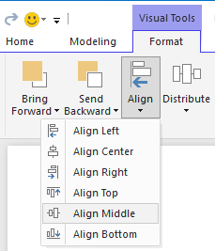
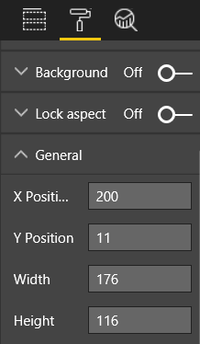
PUG2 – pug2, alignment, NOTES
Doesn’t mean same size, same # in each row/col. =structure that aids nav and readability.
How-to
PBID “Align and Distribute” on “Visuals” ribbon tab.
<show> PBIS, General tab.
Align to L/R edges, align rows H&V. Slicers to left.
Notes:
How-to:
Resize cards to same, remove redundant heading, align H.
Align tops of vizs first row.
Align bottoms 2nd row.
Align columns

Slide 46
PUG2, pug3, Fit to space, NOTES
Make best use of space U have.
If know how will be viewed, design in mind.
Reduce empty space to fill canvas
Try to elim scrollbars on vizs
Fill space w/o seeming cramped
DEMO Page Size tab (Page2s)
DEMO removing scrollbars
Notes:
Small screen, huge screen, tablets, mobile, ALL?

Slide 47
PUG2-Page 2s, Fit to space > Adjust page size, NOTES
How-to
Cramped. Format>Page size> height 900.
First change it to 16:9
THEN change 720 > 900

Slide 48
PUG2-pug3, Fit to space > reduce clutter, NOTES "Perfection is achieved, not when there is nothing left to add, but when there is nothing left to remove” – Antoine de Saint-Exupery
Cluttered hard to u/s at-a-glance. Too overwhelming, reader wont’ even try.
Remove bells whistles unnecessary. If doesn’t aid comp or nav, remove it.
Will give us more space to apply BP we learned in “alignment”
How-to
Remove arrow, backg, textbox, 1 viz (Count host city) to another page
Lengthen page size to increase whitesp
Add shape to group col charts
Notes:
Data-to-ink ratio. Tufte.
The non-erasable core of the graphic or the report

Slide 49
PUG2-pug4, Fit to space > tell story at glance, NOTES
Overall test: someone w/o prior/new knowledge can grok w/o explanation from anybody
Quick glance: quickly see what page is about, what each viz is about
Eyes drawn to element you want them to look at first. After that, eyes will move LtoR, TtoB. Change this behavior by adding visual cues like textb, shapes, borders, size, color.

Slide 50
PUG2-pug4, Fit to space > tell story at glance>text boxes, NOTES
SomeT titles on vzs aren’t enough to tell story.
Textb can describe page, group of vizs, indiv viz. Explain results, better-define viz/component in viz, rela tw vizs. Draw attention based on diff. criteria called out in textb.
Don’t overdo – too much text on page is distracting and detracting. If find rpt requires ton of text to make it u/s-able, start over. Can you pick a diff viz that tells a better story on its own? Can you tweak vizs’ titles?
How-to
Add text box – I don’t do this in my example.
Use Page 5.
Notes:
In Desktop, select Insert > Text Box.
Add “ For each countryregion on map, click to highlight how they did year to year in line graph and how the medals are distributed in the matrix. Use slicer to focus map. Drill into matrix to events.

Slide 51
PUG2-pug4, Fit to space > tell story at glance>text, NOTES
Create text styleguide and apply to all pages of report. Pick few font faces, sizes, colors.
Apply to not only textual elements but also font choices within your vizs.
Set rules for using bold, italics, increased font size, certain colors, etc.
How-to
Title, Sego Bold 28.
Remove backg
Titles, labels, legends to black
Cards: Cat label off, title on 12p black centered
Viz titles: if On, 12p left-align
Slicers: Header off, Title on. Items >text grey 10p
Scatter, Col: black font axes and axes titles, if used.
Notes:
Try to avoid ALL CAPS or underlining.
Text is like color: Use sparingly and appropriately for maximum impact

Slide 52
PUG2-pug4, Fit to space > tell story at glance>shapes, NOTES
Can aid nav and comprehension.
Group related info together, hilite important, arrows to direct the eye.
Help readers u/s where to start and how to interpret report. (in design terms, referred to as “contrast”)
How-to
Didn’t do this to my example, show and then remove.
Add shape – added to pug2 (box, 2 lines)
Add arrow
Notes:
In PBID, Insert > Shapes

Slide 53
PUG2-pug4, Fit to space > tell story at glance>color, NOTES
Use color for consistency
Deliberate in selection of color so doesn’t detract from groking
Too many bright barrages
Backgrounds
Don’t overshadow report, clash, hurt eyes
Watch out for inherent meaning
Not creating work of art, but functional report.
Notes:
This section is more of what NOT to do with color.
A study on the use of color and visualizations within Web pages found that higher contrast between colors increases the speed of comprehension (The effect of text and background colour on visual search of Web pages and Determining Users’ Perception of Web Page Visual Complexity and Aesthetic Characteristics
Using the same chart or a consistent and meaningful color scheme allows people to use the same perceptual strategy for interpreting the data which saves time, energy, and cognitive overload.

Slide 54
PUG2-pug5, Fit to space > tell story at glance>color, NOTES
How-to
Change backg to black.
Page title: Fix since it too was black – change to text box title. Select textb, erase text, Viz>Title>On. Title>Title text>Summer Olympic Games. Font color white.
Card: Backg On, white, transp 0%. Title on, font white, backg black.
Slicers: make formatting same. Backg aqua – good choice because part of the page’s color palette, see it in map, areamap, col chart. Add thin white border. Items color to white. Title > Font color> white. Add black backg.
Rectangle shape: was black so now invisible. Select shape>format>backg ON.
Col, bubble, map, areamap: add white backg. Format>Line>Line color> white with weight>3.

Slide 55
PUG2-pug5, Aesthetics, NOTES
Much of this covered already. Just few more BPs re: overall appearance of report.
Function is to meet biz need, not be pretty. But some level of beauty required, esp when comes to 1st imps.
If page looks disorg, confusing, unprof… reader may never discover powerful story it tells
Concentrate on:
Creating common theme or look, and apply to all pages
Using standalone imgs and other graphics to support and not distract from the real story
Applying all the bps learned so far
Notes:
. Nashville consultant Tony Bodoh explains "Emotion fires a half-second before logic can kick in." Readers will first react at an emotional level to your report page, before they take more time to dig deeper.
TDI blogger and TechTarget industry analyst Wayne Eckerson has a great analogy. Designing a report is like decorating a room. Over time you purchase a vase, a sofa, end table, a painting. Separately you like all of these elements. But although each individual selection makes sense, collectively the objects clash or compete for attention.

Slide 56
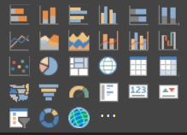
Visual design best practices

Slide 57
Choose the right visual
What story am I trying to tell with this visual?
Which visual will tell the story best?
Categorical (dimensions) vs quantitative (measures, metrics)
Categorical can be classified, represent different subsets of data
Quantitative is typically numeric, is countable and measurable
Avoid scrolling
Your visual may still need help
Notes:
We’ve looked at report design..how to organize report elements in a way that makes the report easy to grasp.
Now focus on design b for vizs themselves.
Leave report page alone for a while and, at the end, apply BP all at once.
Just as imp to plan out your report 4 start building….each viz also requires planning. Avoid tempta to use fancy or more-complex viz types just to make your report look more interesting or sophisticated. Horiz bar charts and simple line charts can convey info quickly, and they’re familiar and comfortable.
You could show progress through a sales cycle as a bar chart but wouldn’t a Waterfall or Funnel tell it better?
Don’t be surprised if the first visual type you pick doesn’t end up being your best option. Try more than one visual type to see which one makes the point best.
know which visual types work best with what type of data
Scrolling: choose other viz or use filters/drilldown. If can’t escape scroll, horiz tolerated better.
Even when choose abs-best viz for the story, may still need help telling story – use textb, labels, titles, menus, legends, color, size, shapes.

Slide 58
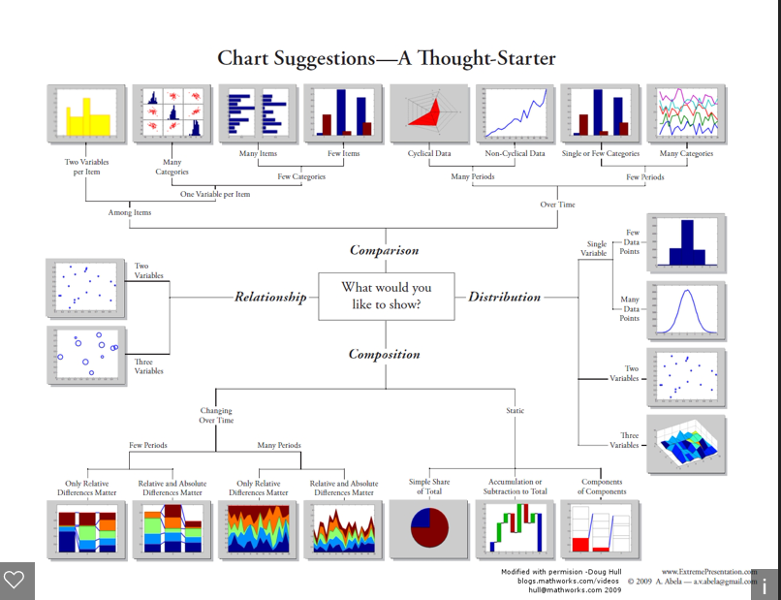
Notes:
Dr. Andrew Abella

Slide 59
Choose the right measure
Is the story your visual telling compelling? Does it matter?
What is the best way to measure/show this piece of the story?
Notes:
Don’t build visuals for the sake of building visuals. Maybe you thought the data would tell an interesting story, but it doesn’t. Don’t be afraid to start over and look for a more-interesting story. Or, maybe the story is there but it needs to be measured in a different way.
For example, say you want to measure the success of your sales managers. What measure would you use to do this? Would you measure that best by looking at total sales or total profit, growth over previous year or performance against a target goal? Salesperson Sally might have the largest profit, and if you showed total profit by salesperson in a bar chart, she would look like a rockstar compared to the other salespeople. But if Sally has a high cost of sales (travel expenses, shipping costs, manufacturing costs, etc.), simply looking at sales doesn’t tell the best story.

Slide 60
Distorting reality erodes trust
Avoid temptation to MAKE your visual tell a particular story. Customers will see through it – and be disappointed in you/company.
Don’t make claims (in titles, headings, pagenames) that are not supported by the visual(s)
Here are some fun examples…
Notes:
It’s so easy to manipulate our vizs to distort the truth.
Personally, any time I notice that a graph is deceptive, I also assume that the numbers behind the graph are probably deceptive as well

Slide 61
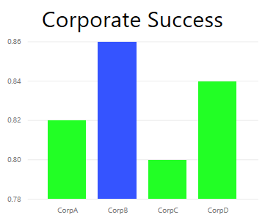
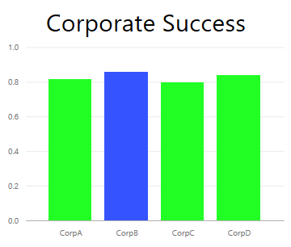

Slide 62
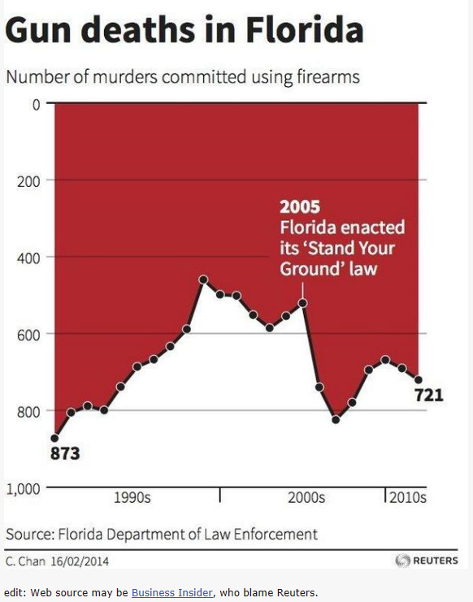

Slide 63
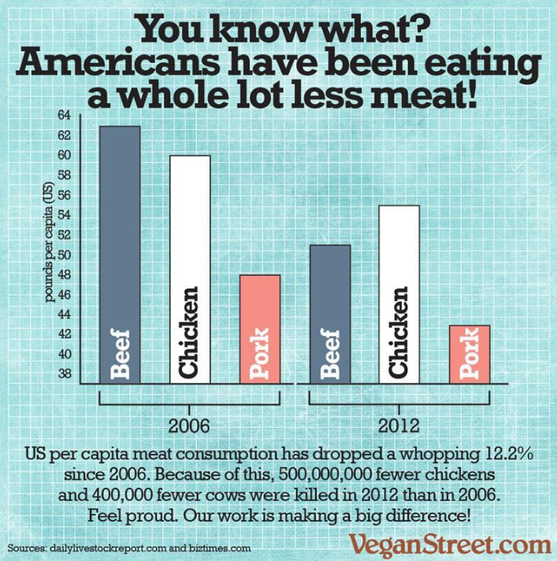
Notes:
Starts at 37, Y axis doesn’t match grid, . 12% is pretty signif, why distort it to look like 50%? Pork?Pigs?

Slide 64
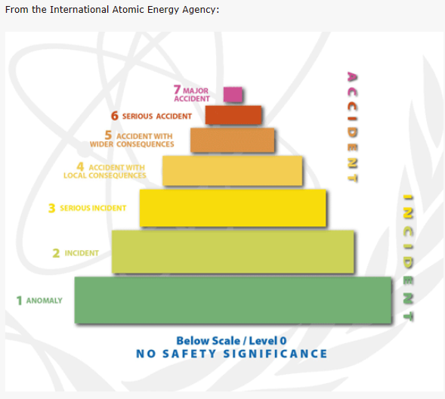

Slide 65
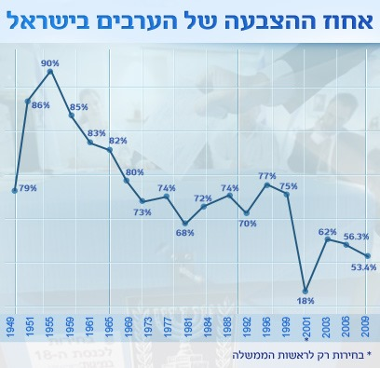
Notes:
Strange intervals, 79 lower than 77

Slide 66
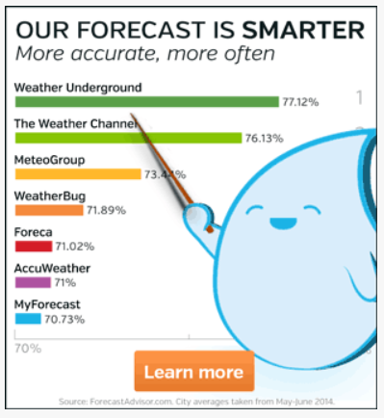
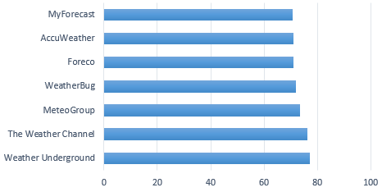

Slide 67


Slide 68


Slide 69


Slide 70



Notes:
Logarithmic scale, leading to skewed data relationships. Because the differences in bar heights represents their logarithmic differences rather than linear differences in value, they'll confuse the audience. You might solve the scaling problem--the fact that some values are extremely high compared to the others--by using two graphs: one regular bar graph with a linear scale that includes the full range of values to show the huge differences that exist, and a second bar graph with a linear scale that only includes the values that aren't extremely high, which will make it possible for people to see and compare the small values. FEW
Danz: When values are that much different I prefer not to use a common graph for all the values. Instead I can use common scaled minibars in a sorted by totals table to quickly pick the magnitude of the values.

Slide 71


Notes:
The Guardian is outraged by a pie chart (Photo taken by Engadget) used by Steve Jobs at MacWorld to illustrate the iPhone’s marketshare, calling him the "king of snake oil salesman" due to its deceptive representation of relative percentages.
Perspective.

Slide 72

Notes:
This graph shows a visually large increase in value over time without either context, leading a casual or naive observer to conclude that the increase in "social networking" job trends is large and significant. While the increase is relative large it's hard to agree that it's absolutely significant, particularly absent any comparison to measures of other job trends during the same period.

Slide 73


Slide 74


Slide 75

Notes:
What is the red bar. Hard to see diamond.

Slide 76

Notes:
3D slant makes it hard to read exact value.

Slide 77



Slide 78


From Darkhorse Analytics, Joey Cherdarchuk, 2014
Notes:
The chart is clean, with axes lightened so the data is in the foreground, and the series direct labelled. Unfortunately it is not very effective at conveying much beyond "There is lots of pillaging." If we look closely we may also see a slight upward trend in Thieving and in revenues overall, but insights beyond that are all obscured by our chart choice.
The problem with stacked charts is that only the first series, in this case Thieving, and the total of all series are clearly displayed. Everything else is distorted by the shifting baseline of the series beneath it. If you want to note patterns in the individual series, stacked charts are inadequate.
The solution in this case is to simply make a small chart for each series. Often called "small multiples" these charts reveal the patterns for each series and let us compare between the series. To give a sense of the proportions of the different series we can add another chart specifically for that purpose. What pops out now is a rather interesting change in Plundering which was previously hidden.

Slide 79

And now, back to visual design best practices

Slide 80
Elements of visual design
Layout, space, size
Text elements: labels, annotations, menus, titles
Sorting
Visual interaction
Color
Notes:
Once you’ve selected a type and measure and created the visual, it’s time to fine-tune the display for maximum effectiveness

Slide 81
Great animated gifs from Darkhorse Analytics
http://blog.darkhorseanalytics.com/data-looks-better-naked
http://blog.darkhorseanalytics.com/clear-off-the-table
http://blog.darkhorseanalytics.com/salvaging-the-pie
http://blog.darkhorseanalytics.com/data-looks-better-naked-maps-edition

Slide 82
Tweaking for best use of space
Tufte’s data-ink ratio
Large enough to read, dark enough to read
Demo: Resize visual, move visual
Notes:
If you have a proportionally-larger visual on the page, readers may assume it’s the most important. Put enough space between the visuals that your report doesn’t look cluttered and confusing. Align your visuals to help direct the eyes of your readers.

Slide 83
Titles and labels that are part of the visual
Readable
Self-explanatory
Large enough, dark enough, good color choice
Use styleguide for font size, face, color, emphasis
Demo:
Formatting pane > turn on X-axis, Y-axis, data labels, legend
Text size – titles, data labels (not X or Y axes or legends)
Text alignment – choose and apply same settings to all on page
Text position – for some Y axes and for the legend. Apply same to all on page
Title and label length – titles, axes titles, data labels, legends.
Text color – titles, axes, data labels
Notes:
Text in titles and labels must be an optimal size with colors that stand out (such as black instead of the default grey). Limit the number of colors and sizes -- too many different font sizes and colors make the page look busy and confusing. Consider using the same font color and size for the title of all visuals on a report page and choose the same alignment for all titles on a report page.
For data labels – play with display units and decimal places…optimal.
For title and label length - . If you decide to display any of these elements, adjusting the length (along with text size) ensures that nothing is truncated. For Title and Legend, the setting is Title Text and this is where you type in the actual title that will appear on the visual. For X-Axis and Y-Axis, the setting is Style and you select from a dropdown. For Data labels, the settings are Display and Decimal. Use the Display dropdown to select the units of measurement: millions, thousands, none, auto, etc. Use the Decimal field to tell Power BI how many decimal places to display.

Slide 84
Titles and labels that are not part of the visual
Demo:
Text boxes – consistent use of fonts, sizes, colors, alignment
Notes:
Earlier in this paper we discussed adding text boxes to report pages. Sometimes the titles on visualizations aren’t enough to tell the story. Add text boxes to communicate additional information to the readers of your reports.

Slide 85
Sorting
Simple trick to provide faster insight
Demo: Ascending or descending based on values
Notes:
A really simple opportunity to provide faster insight is to set the sorting of visuals.
Example: Sorting in descending or ascending order based on the value in the bars enables you to quickly show significant incremental information without using more real estate.

Slide 86
Visual interaction and interplay
By default, visuals are cross-highlighted. When you select a data point, the related data of other charts light up and the unrelated data dims. You can override this behavior.
Demo: Filter, Highlight, do nothing.
Notes:
One of the most compelling feature of Power BI is the ability to edit the way charts interact with each other.
You can override this behavior to use any chart as a true filter which saves you real estate on your page.
Not all visuals can be highlighted, for those you won’t see the highlight control.
TIP: For readers who’re new to Power BI, this ability to click and interact with reports may not be instantly obvious. Add text boxes to help them understand what they can click on to find more insights.

Slide 87
Use of color in visuals
Have a plan (styleguide)
Use color to tie page together, add emphasis to important data, improve comprehension of the visual.
Know your audience and any inherent color “rules”
Power BI applies default color theme, which you can override.
Notes:
Same principles apply. Too many colors is distracting and makes difficult reader know where to look.
Don’t sacrifice comprehension for beauty.
Default theme: chosen to provide variety and contrast.

Slide 88


Use color to highlight interesting data Demo: Data colors > Show all
Notes:
Change one or more data point’s color to call attention to it.
This example, 2yr vs 4yr cycle
PBID – can hilite outliers or section of a line by using a second series.
Here, values in the ‘Outliers’ series only exist where the average August temperature drops below 60. This was done by creating a DAX calculated column using this formula:
Outliers = if(Editions[Temp]<60, Editions[Temp], BLANK())
In our example, there were 3 outliers: 1952, 1956, and 2000.

Slide 89
Colors for labels and titles
Many options for labels and titles and axes titles…
Stick with your styleguide
Notes:
As with all the guidelines in this paper, there are always situations and reasons to “break the rules”, but if you do decide to break the rules, do it for a good reason.

Slide 90


Colors for categorical values
Charts with a series typically have a categorical value in the legend.
Demo: overriding colors > Data colors
Notes:
For example, each color in the legend below represents a different category of Country/Region. Default colors have been applied by PBI. PBI defalt colors provide a good color separation so they are easy to distinguish.
Be careful when overriding, in this example a color range was chosen from the corporate palette. But it can lead to misinterpretation. The hue and intensity in the 2nd chart implies a false sense of ordering between categories. Implies darker bubbles are higher or lower on some scale.

Slide 91


Colors for qualitative values
Inherent order and numerical value.
Can color data points by the value.
Allows for 2 variables to be shown on a single chart.
Helpful to show spread of values across the data,
Helpful to show variance around a central theme/value.
Demo: Color saturation field, then formatting > Data colors
Notes:
For example this chart makes it clear that although Diesel cars amount for the highest sales, SUVs have the highest margin.
Variance: positive green, negative red.

Slide 93

Apply all of this to our report
Demo

Slide 94
NOTES:
Slicer: removed blanks from the slicers by adding a page level filter and selecting only gold, silver, bronze. Changed Selection Controls to Off for Single Select and Select All.
Bubble: there are so many items in the legend that they scroll off the screen. Removed the legend and turned on Category labels instead. Customers can hover over the bubbles to see the details. Shortened the title and removed “by countryregion” since that seems self-evident. Turned axes labels On for both to make the chart easier to understand.
Filled map: changed the Data colors to make it stand out more. Turned Diverging on and set the Minimum to pink and the Maximum to red.
Area map: removed filter which was set for only USA. Set the Data labels to 1 decimal place. The visual was using the Class field which isn’t very useful since it will almost always be 33% (Gold/Silver/Bronze). Selected a different more-interesting field, Event Gender. Changed Aquatics to blue and Athletics to grey for design
Top bar chart: shortened the title, removed data labels, turned Legend title off. Changed word order of title to match the chart below.
Bottom bar chart: sorted by year ascending to match chart above. Changed colors to match class. Changed title. Turned off legend for more space for data. Tried to turn on data labels and didn’t work. Added count of athletes to Tooltips, didn’t do anything .
Interactions: todo Summer Games: filters have no effect. Medal class do nothing to top column chart. Why doesn’t medal class slicer impact area chart ?
How do I move shape to back. How does tooltips work?
Should be able to use Tooltip field well
Should do, but if it’s not related you might get odd data…
Data probably not related

Slide 96


